Slide 1
Section-2 Descriptive Versus Explanatory Analysis
From Engagement to Conversion

Slide 2
From Engagement to Conversion
This chapter, expand the knowledge of explanatory analysis and show how to use decision trees to understand the drivers behind consumer behavior.
First comparing and explaining the differences between logistic regression and decision tree models, and then discuss how decision trees are built and trained.
Next, discuss how a trained decision tree model can be used to extract information about the relationships between the attributes (or features) of individual consumers and the target output variables.
For programming exercises, use the bank marketing dataset from the UCI Machine Learning Repository to understand the drivers behind conversions.
Start with some data analysis for better understand the dataset;

Slide 3
From Engagement to Conversion
Then, build decision tree models by using the scikit-learn package in Python and the rpart package in R.
Finally learn how to interpret these trained decision tree models by visualizing them using the graphviz package in Python and the rattle package in R.
By the end of this chapter, will be familiar with decision trees and will have a better understanding of when and how to use them with Python or R.
In this chapter, cover the following topics:
Decision trees
Decision trees and interpretations with Python
Decision trees and interpretations with R

Slide 4
Decision trees-Logistic regression versus decision trees
A logistic regression model learns from the data by finding the linear combination of the feature variables that best estimates the log odds of event occurring.
Decision trees, learn from the data by growing a tree.
The main difference between the logistic regression and decision tree models is the fact that logistic regression algorithms search for a single best linear boundary in the feature set, whereas the decision tree algorithm partitions the data find the subgroups of data that have high likelihoods of an event occurring.
It will be easy to explain this with the following diagram:

Slide 5
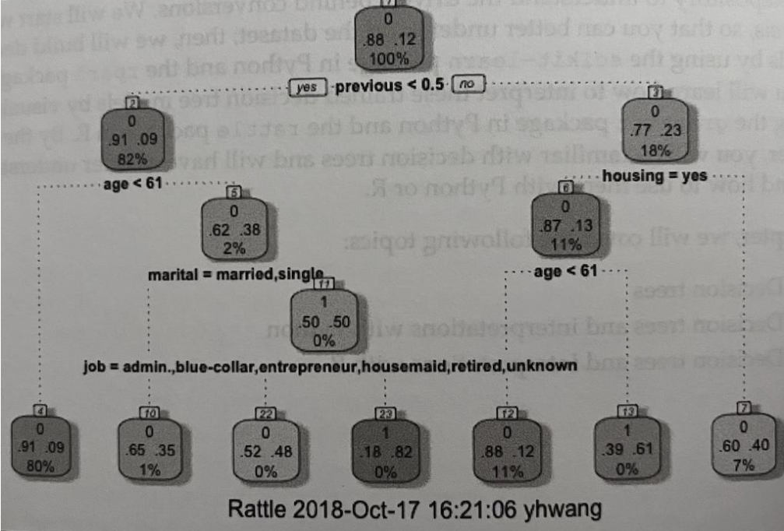
Decision trees-Logistic regression versus decision trees

Slide 6
Decision trees-Logistic regression versus decision trees
This is an example of a decision tree model.
From the above diagram, it partitions the data with certain criteria.
In this example, the root node is split into child nodes by a criterion of previous <0.5.
If this condition is met and true, then it traverses to the left child node. If not, then it traverses to the right child node.
The left child node is then split into its child nodes by a criterion of age. The tree grows until it finds pure nodes (meaning that all of the data points in each node belong to one class) or until it meets certain criteria to stop, such as the maximum depth of the tree.
In the diagram, the data are split into seven partitions. The leftmost node or partition at the bottom is for those data points with values less than 0.5 for the previous variable and with values less than 61 for the age variable.

Slide 7
Decision trees-Logistic regression versus decision trees
On the other hand, the rightmost node at the bottom is for those data points with values greater than 0.5 for the previous variable and with values other than yes for the housing variable.
One thing that is noticeable here is that there are a lot of interactions between different variables. No single leaf node in this example tree is partitioned with one condition.
Every partition in this tree is formed with more than one criterion and interactions between different feature variables.
This is the main difference from logistic regression models.
When there is no linear structure in the data, logistic regression models will not be able to perform well, as they try to find linear combinations among the feature variables. On the other hand, decision tree models will perform better for non-linear datasets, as they only try to partition the data at the purest levels they can.

Slide 8

Growing decision trees
When we are growing decision trees, the trees need to come up with a logic to split a node into child nodes.
There are two main methods that are commonly used for splitting the data: Gini impurity and entropy information gain. Simply put, Gini impurity measures how impure a partition is, and entropy information gain measures how much information it gains from splitting the data with the criteria being tested.
Let's take a quick look at the equation to compute the Gini impurity measure:
Here, c stands for the class lables, p_{i} stands for the probability of a record with class label I being chosen.
By subtracting sum of squered probabilities from one, the Gini impurity measures reaches zero. i.e when all records in each partition or node of a tree are pure with a single target class

Slide 9
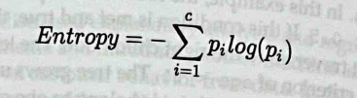
Growing decision trees
The equation to compute entropy is as follows:
Like before, c stands for the class labels, and P, stands for the probability of a record with the class label i being chosen.
When growing the tree, the entropy of each possible split needs to be calculated and compared against the entropy before the split.
Then, the split that gives the biggest change in entropy measures or the highest information gain will be chosen to grow the tree.
This process will be repeated until all of the nodes are pure, or until it meets the stopping criteria.

Slide 10
Decision trees and interpretations with Python
In this section, learn how to use the scikit-learn package in Python to build decision tree models and interpret the results via visualizations using Python's graphviz package.
Start this section by analyzing the bank marketing dataset in depth, using the pandas and matplotlib packages, and then we will discuss how to build and interpret decision tree models.
For this exercise, use one of the publicly available datasets from the UCI Machine Learning Repository, which can be found at https://archive.ics.uci.edu/ml/ datasets/bank+marketing.
You can follow the link and download the data in ZIP format. We will use the bank. zip file for this exercise.
When you unzip this file, there are two CSV files: bank.csv and bank-full.csv.
Use the bank-full.csv file for this Python exercise.
In order to load this data into your Jupyter Notebook, run the following code:

Slide 11
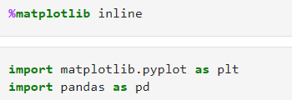

Decision trees and interpretations with Python

Slide 12
Decision trees and interpretations with Python
From the above code snippet, use the matplotlib inline command to show plots on the Jupyter Notebook.
Then, import the matplotlib and pandas packages for the data analysis step.
Lastly, read the data file by using the read_csv function in the pandas package.
One thing to note here is the sep argument in the read_csv function.
The fields in the bank-full.csv file are separated by semicolons (;), not commas (,)
In order to correctly load the data into a pandas DataFrame, specify in the read_csv function to use semicolons as the separators, instead of commas.
Once loaded the data, it should look like the following screenshot:

Slide 13
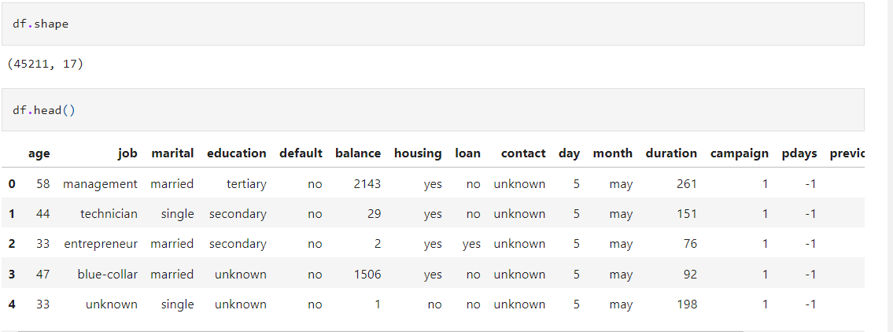
Decision trees and interpretations with Python

Slide 14
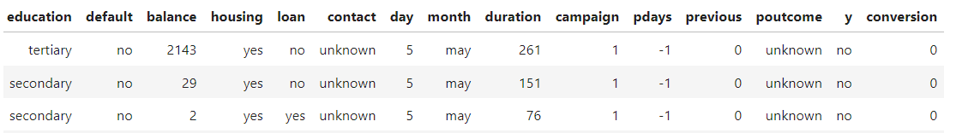
Data analysis and visualization
Before start to analyze the data, first encode the output variable, y, which has information about whether a customer has converted or subscribed to a term deposit, with numerical values.
Use the following code to encode the output variable, y, with zeros and ones:
From this code snippet, use the apply function to encode the output variable.
Stored these encoded values in a new column, named conversion.

Slide 15
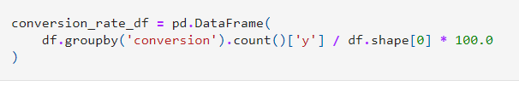
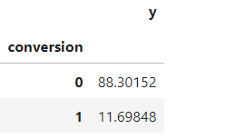
Conversion rate
The conversion rate is simply the percentage of customers that subscribed to a term deposit. Refer the below code :
From this code snippet, grouping by a column, conversion, which is encoded with 1 for those that have subscribed to a term deposit, and with 0 for those that have not. Then, counting the number of customers in each group and dividing it by the total number of customers in the dataset.
The result looks as follows:
There is a large imbalance between the conversion and non-conversion group
which is common in marketing data set .

Slide 16
Conversion rates by job
It might be true that certain job categories tend to convert more frequently than others.
Let's take a look at the conversion rates across different job categories. This can be achieved by using the following code
First group by the column, job, which contains all information about the job category that each customer belongs to.
Then, we sum over the conversion column for each job category, from which we get the total number of conversions for each job category.
Lastly, we divide these conversion numbers by the total number of customers in each job category, in order to get the conversion rates for each job category.
The results look as follows:

Slide 17
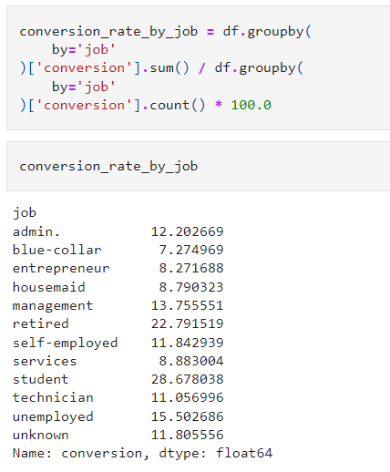
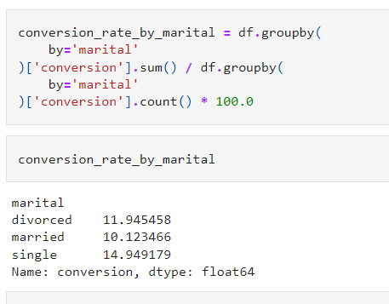

Slide 18
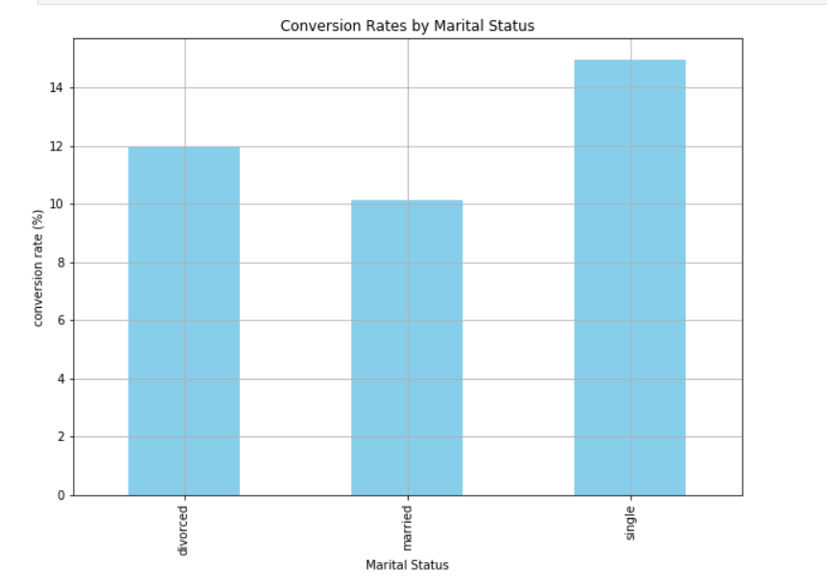
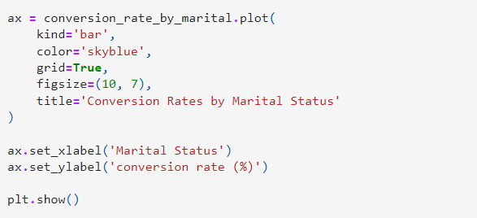
Decision trees and interpretations with Python

Slide 19
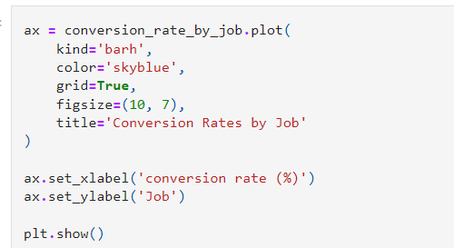
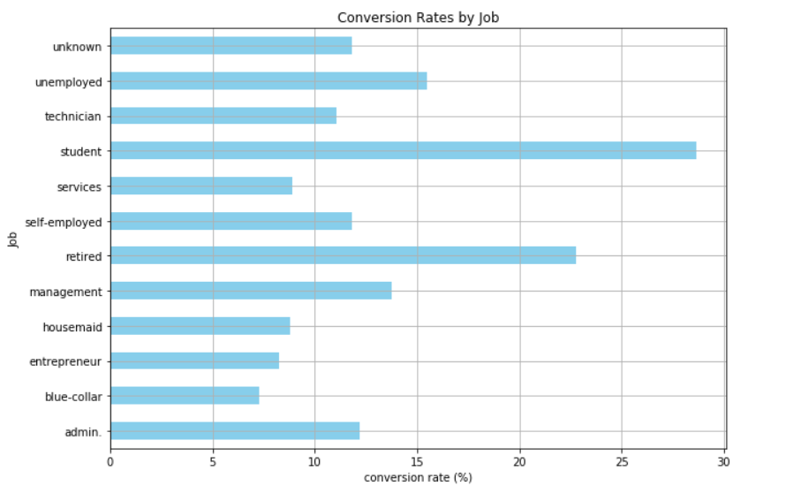
Decision trees and interpretations with Python

Slide 20
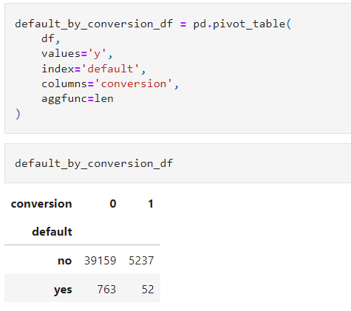
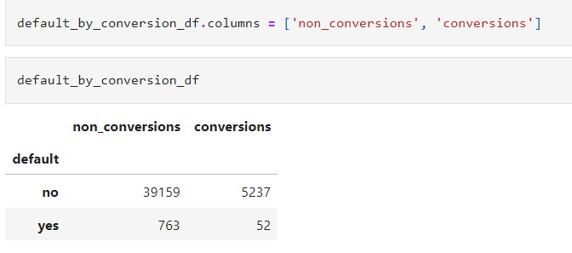
Default rates by conversions
Another attribute of a customer that would be interesting to see is the default rate, and how it differs between those who subscribed to a term deposit and those who did not.
Use pivot_table function to analyze the default rates by conversions.
By using len as the aggregation function, count how many customers fall under each cell of the pivot table.

Slide 21
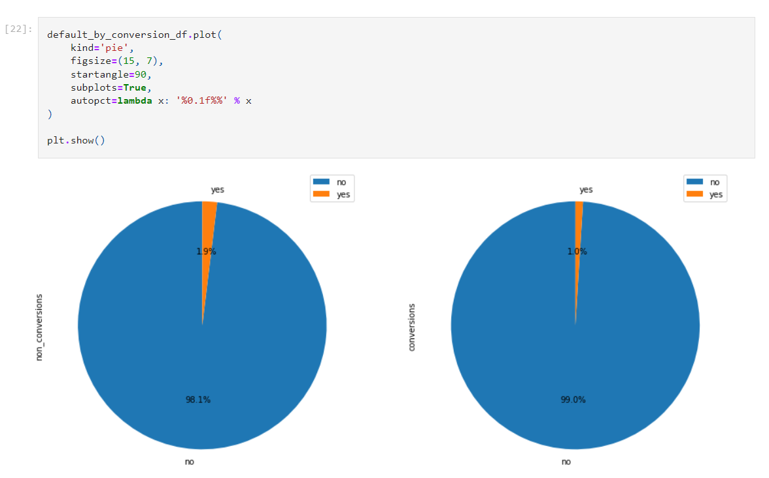

Slide 22
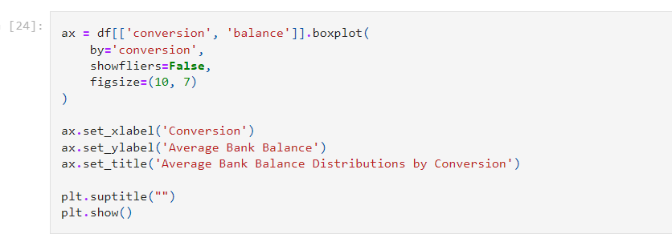
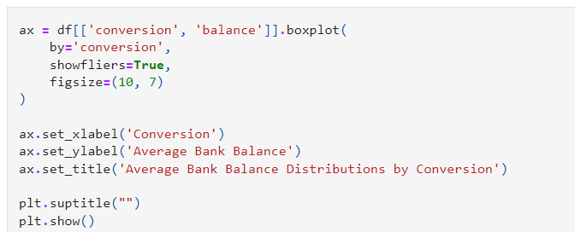
Bank balances by conversions
Next, try to see if there are any differences in the distributions of bank balances between the conversion and non-conversion groups.
A box plot is typically a good way to visualize the distribution of a variable.
Let's take a look at the following code:

Slide 23
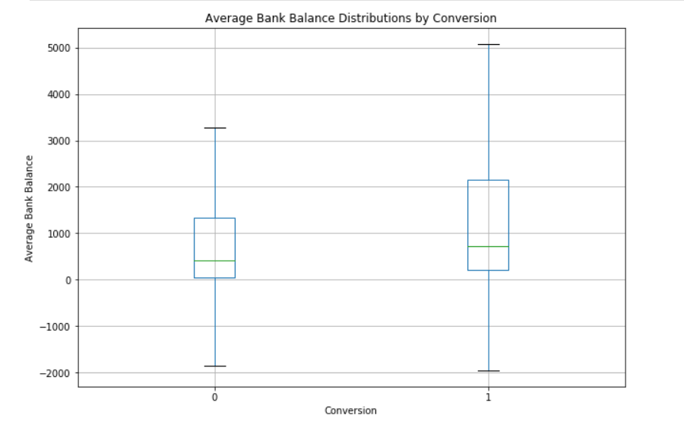
Bank balances by conversions
From the boxplot, the bank balance is slightly higher for the conversion group as compared to non-conversion group
Also bank balances of converted customers seem to vary more than those of non-converted customers

Slide 24
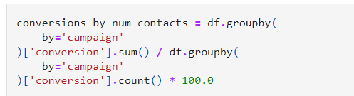
Conversion rates by number of contacts
Look at how the conversion rates vary by the number of contacts.
Typically, in marketing, a higher number of marketing touches can result in marketing fatigue, where the conversion rates drop as you reach out to your customers more frequently.
Find whether there is any marketing fatigue in our data with the following code.
In this code snippet, grouping by the campaign column (which has information about the number of contacts performed during the marketing campaign for this customer) and computing the conversion rates for each number of contacts.

Slide 25
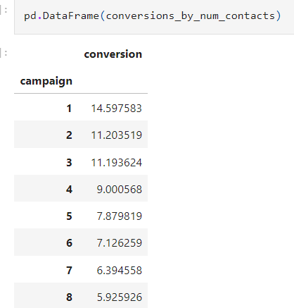
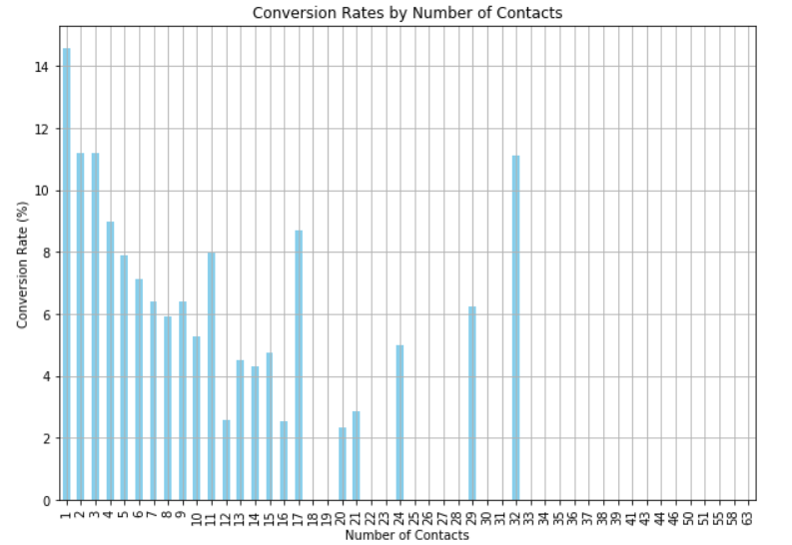
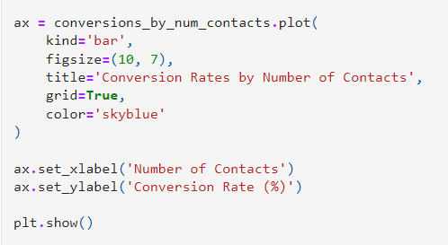
Conversion rates by number of contacts
The resulting data appears as follows:

Slide 26
Encoding categorical variables
There are eight categorical variables in this dataset: job, marital, education, default, housing, loan, contact, and month.
Before starting to build decision trees, encode these categorical variables with numerical values.
Encoding months: There can only be 12 unique values for the month variable.To know the values in our dataset run following code:
df ['month'].unique ()
From the result, as expected, we have 12 unique values for the month column, from January to December.
One way to encode the string values of month with numbers is shown as follows:

Slide 27
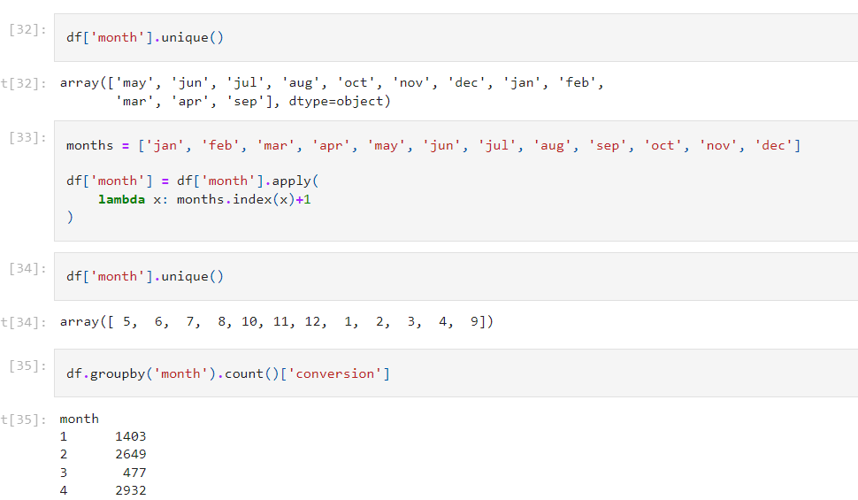
Encoding categorical variables

Slide 28
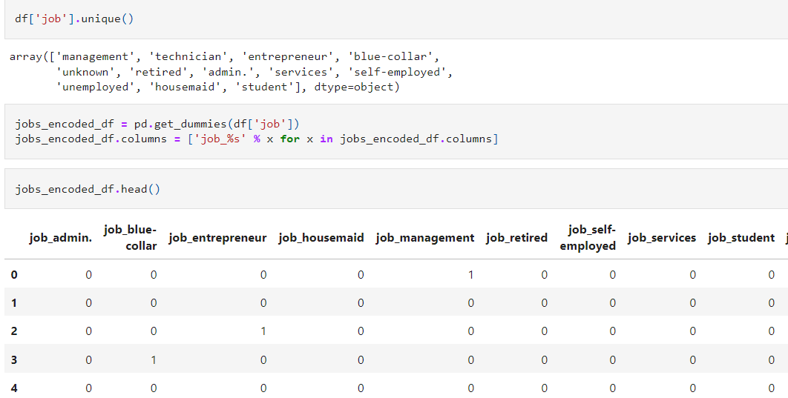

Encoding 'job'

Slide 29
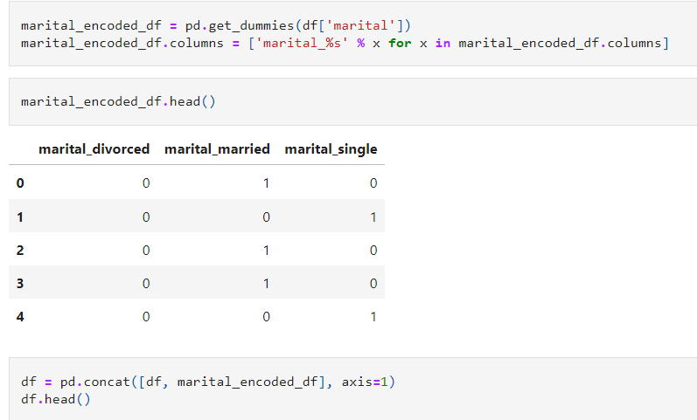
Encoding 'marital'

Slide 30
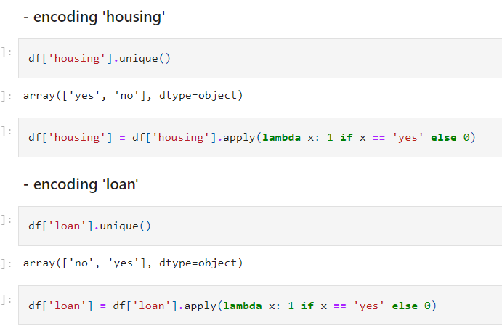
Encoding 'housing’ & 'loan'

Slide 31
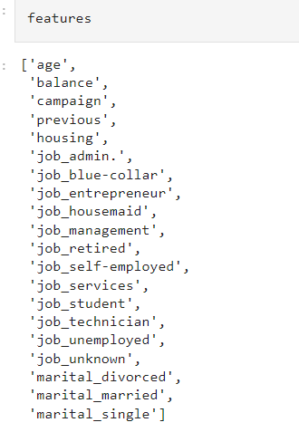
Building a Decision Tree
Use the following features to build a decision tree.

Slide 32

Building a Decision Tree
To build and train a decision tree model with Python, we are going to use the tree module in the scikit-learn (sklearn) package.
Import the required module by using the following line of code:
From sklearn import tree
Under the tree module in the sklearn package, there is a class named DecisionTreeClassifier, which we can use to train a decision tree model.

Slide 33

Building a Decision Tree
There are many arguments to the DecisionTreeClassifier class, aside from the one that we are using here, max_depth.
Themax_depth argument controls how much a tree can grow, and here, we limit it to 4, meaning that the maximum length from the root to a leaf can be 4.
Use the criterion argument to choose between the Gini impurity and the entropy information gain measures for the quality of a split.
In order to train this decision tree model, use the following code:
From this code, the fit function takes two arguments: the predictor or feature variables and the response or target variables.
In our case, response_var is the conversion column of the DataFrame, df.
Once you have run this code, the decision tree model will learn how to make classifications.

Slide 34
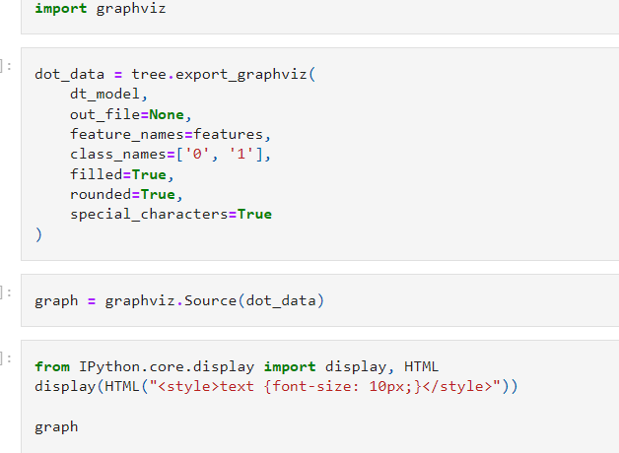
Interpreting Decision Tree Model

Slide 35
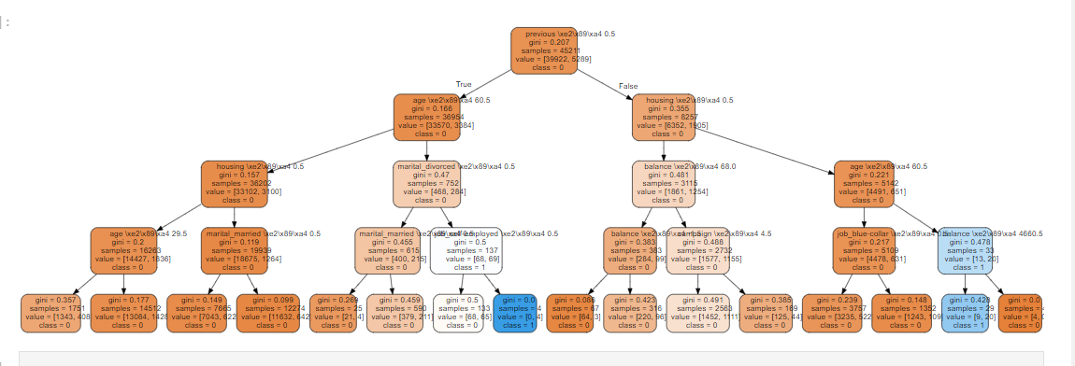

Slide 36
Interpreting Decision Tree Model
Each node contains five lines that describe the information that the given node has.
The top line tells us the criteria of the split. The root node, for example, is split into its child nodes based on the value of the previous variable.
If the value of this previous variable is less than or equal to 0.5, then it goes to the left child. On the other hand, if the value of this previous variable is larger than 0.5, then it goes to the right child.
The second line tells us the value of the quality measure for the split. Here, selected the gini impurity measure for the criteria, so we can see the changes in the impurity measures in each node.
The third line tells us the total number of records that belong to the given node. For example, there are 45, 211 samples in the root node, and there are 8, 257 samples in the right child of the root node.

Slide 37
Interpreting Decision Tree Model
The fourth line in each node tells us the composition of the records in two different classes.
The first element stands for the number of records in the non-conversion group, and the second element stands for the number of records in the conversion group.
For example, in the root node, there are 39, 922 records in the non-conversion group and 5,289 records in the conversion group.
Lastly, the fifth line in each node tells us what the prediction or classification will be for the given node.
For example, if a sample belongs to the leftmost leaf, the classification by this decision tree model will be 0, meaning non-conversion.
On the other hand, if a sample belongs to the eighth leaf from the left, the classification by this decision tree model will be 1, meaning conversion.

Slide 38
Interpreting Decision Tree Model
Next, draw insights from this tree graph.
To understand the customers that belong to each leaf node, we need to follow through the tree.
For example, those customers that belong to the eighth leaf node from the left are those with a 0 value for the previous variable, age greater than 60.5, a marital_divorced variable with a value of 1, and a job_self-employed variable with a value of 1.
In other words, those who were not contacted before this campaign and who are older than 60.5, divorced, and self-employed belong to this node, and have a high chance of converting.
Let's take a look at another example.
Those customers that belong to the second leaf node from the right are those with a value of 1 for the previous variable, a value of 1 for the housing variable, age greater than 60.5, and balance less than or equal to 4, 660.5.
In other words, those customers that were contacted before this campaign and that have a housing loan, are older than 60.5, and have a bank balance less than 4, 660.5 belong to this node and 20 out of 29 that belong to this node have converted and subscribed to a term deposit.

Slide 39
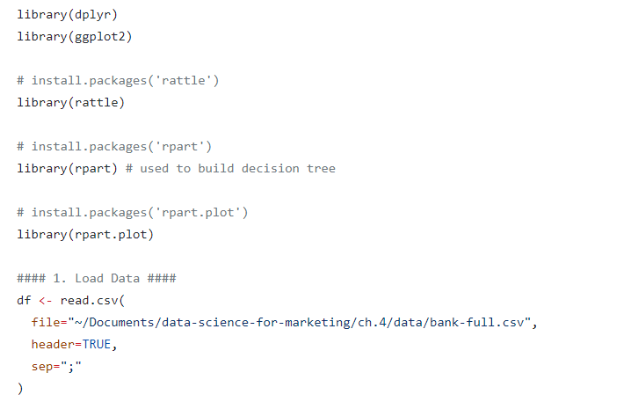
Decision trees and interpretations with R

Slide 40
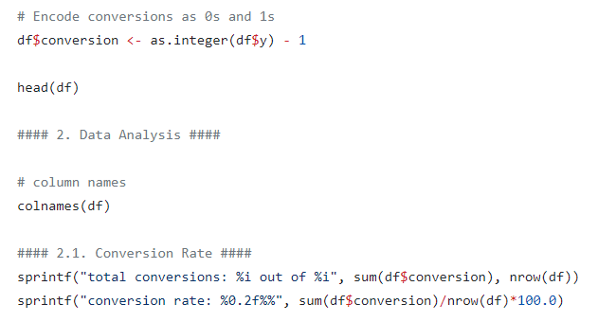
Decision trees and interpretations with R

Slide 41
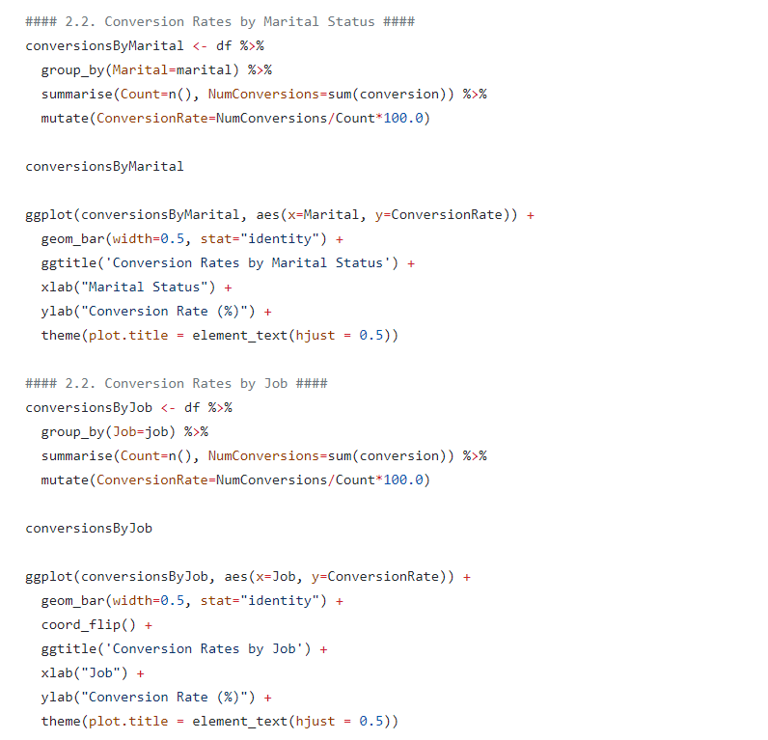

Slide 42
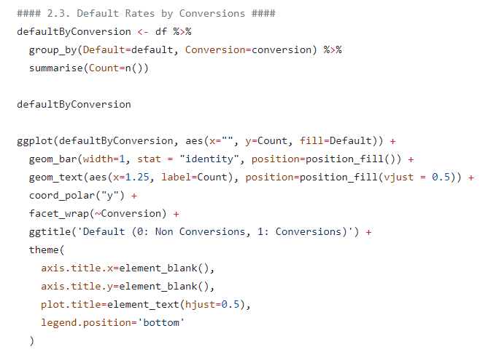

Slide 43
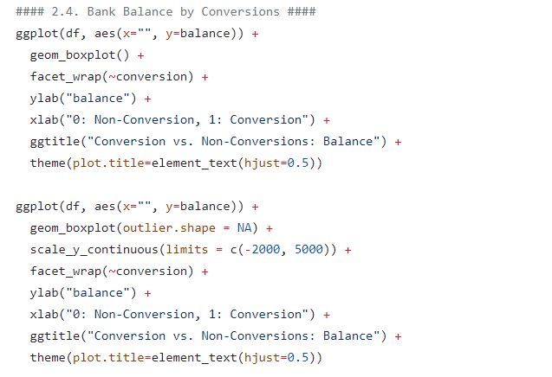

Slide 44
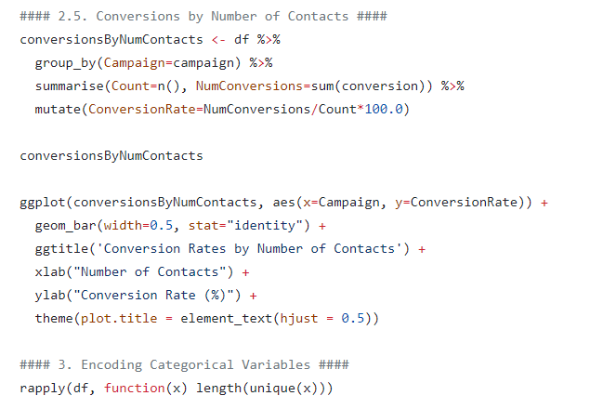

Slide 45
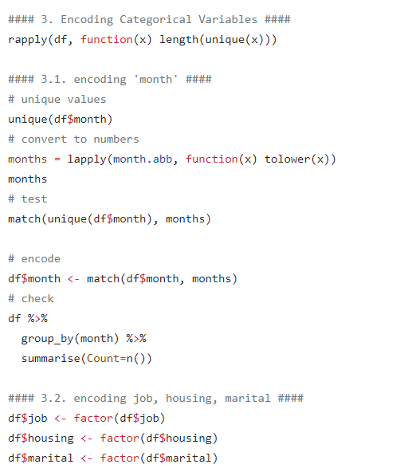

Slide 46
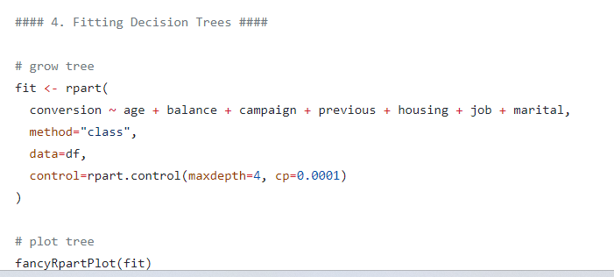
Decision trees and interpretations with R

